Slide 1
Chapter IV: Uncertain Knowledge and Reasoning
By Nguh Prince

Slide 2
PLAN
Quantification of Uncertainty
Bayes’ Rule
Probabilistic Reasoning
Bayesian Networks
First Order Probabilistic models
Probabilistic Reasoning In Time
Inference in Temporal Models
Keeping Track of Many objects
Making Simple Decisions
Utility theory
Utility functions
Decision Networks and Decision Theoretic Experts
Making Complex Decisions
Sequential Decision Problem
Multi-Agent Decisions

Slide 3
Quantification of Uncertainty
AI systems need to model and reason about uncertainty to make informed decisions and mitigate risks.
Probability theory provides a mathematical foundation for quantifying uncertainty and reasoning under uncertainty.
Basic probability notation includes:
Sample space S: The set of all possible outcomes of a random experiment.
Event A: A subset of the sample space S, representing a set of outcomes.
Probability P(A): The likelihood of event A occurring, ranging from 0 to 1.

Slide 4
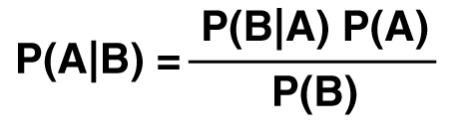
Quantification of Uncertainty - Bayes' Rule and its Use
Bayes' Rule is a fundamental theorem in probability theory that describes how to update beliefs based on new evidence.
Mathematically, Bayes' Rule is expressed as:
where:
P(A∣B) is the probability of event A given evidence B.
P(B∣A) is the likelihood of evidence B given event A.
P(A) and P(B) are the prior probabilities of events A and B respectively.

Slide 5
Quantification of Uncertainty - Bayes' Rule and its Use - Example
Suppose you are a doctor and you have a patient who is exhibiting symptoms that could be indicative of a rare disease, let’s call it Disease X. You know that in the general population, the prevalence of Disease X is very low, estimated to be 1 in 10,000 (0.0001%)
Now, you have a diagnostic test for Disease X. The test is quite accurate, with a sensitivity of 99% (the probability that it correctly identifies someone with the disease) and a specificity of 99% (the probability that it correctly identifies someone who does not have the disease)

Slide 6
Quantification of Uncertainty - Bayes' Rule and its Use - Example
Your patient takes the test, and it comes back positive. What is the probability that your patient actually has Disease X, given that the test result is positive?

Slide 7
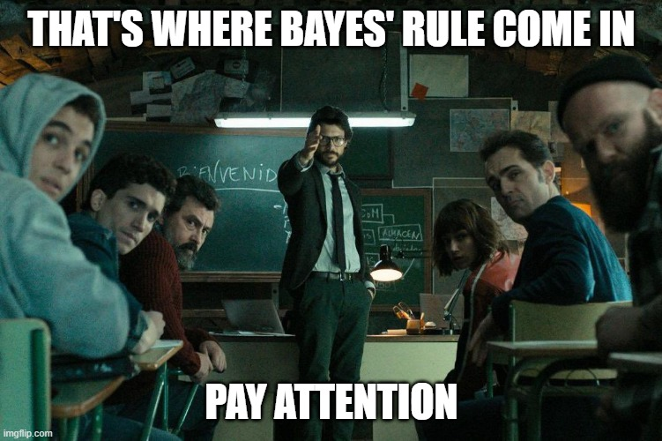
Quantification of Uncertainty - Bayes' Rule and its Use - Example

Slide 8
Quantification of Uncertainty - Bayes' Rule and its Use - Example
Let’s use Bayes’ Rule to calculate this.
First, let’s define the terms:
P(Disease X): probability of the patient having the disease, 0.0001
P(Pos | Disease X): probability that the test is positive, given that the patient has the disease (sensitivity), 0.99
P(Neg | No Disease X): probability of a negative test result given that the patient does not have Disease X (specificity), 0.99
P(Pos): overall possibility of a positive test result, which is the sum of 2 probabilities: probability of a true positive and probability of a false positive.

Slide 9
Quantification of Uncertainty - Bayes' Rule and its Use - Example
Let’s apply Bayes’ Rule:
P(Disease X | Pos) = P(Pos | Disease X) * P(Disease X) / P(Pos)
P(Disease X | Pos) = 0.99 * 0.0001 / P(Pos)
P(Pos) = P(Pos | Disease X) * P(Disease X) + P(Pos | No Disease X) * P(No Disease X)
P(Pos) = 0.99 * 0.0001 + 0.01 * 0.9999
P(Pos) = 0.000099 + 0.009999 = 0.010098
P(Disease X | Pos) = 0.99 * 0.0001 / 0.10098
P(Disease X | Pos) = 0.00098

Slide 10
Probabilistic Reasoning: Bayesian Networks
In uncertain domains, knowledge needs to be represented in a way that captures probabilistic dependencies and uncertainties.
Bayesian networks are used to represent probabilistic knowledge by encoding probabilistic dependencies among variables.
They provide a graphical and mathematical representation of probabilistic dependencies among variables.

Slide 11
Probabilistic Reasoning: Bayesian Networks
Conditional probability distributions (CPDs) in Bayesian networks can be represented in various ways to achieve inference efficiency. We will look at tabular CPDs and compact representations.
Tabular CPDs explicitly specify probabilities for each combination of variable values, suitable for small domains.
Compact representations use conditional linear Gaussian models (CLGM) or decision trees to represent CPDs.

Slide 12
Probabilistic Reasoning: First-Order Probabilistic Models
First-order probabilistic models extend probabilistic reasoning to handle uncertainty in relational domains.
They combine probabilistic graphical models with first-order logic to represent uncertainty about objects and their relationships.
They enable reasoning about complex, structured data with uncertainty.

Slide 13
Probabilistic Reasoning in Time
Time introduces additional complexity and uncertainty in AI systems, as the state of the world evolves over time.
Probabilistic reasoning in time involves modeling and reasoning about uncertainty in dynamic environments where states change over time.

Slide 14
Probabilistic Reasoning in Time: Inference in Temporal models
A temporal model is a mathematical or computational framework used to represent and reason about phenomena that evolve over time.
They capture the dynamic nature of systems, processes or events by explicitly incorporating temporal dependencies, relationships or patterns.
They capture dependencies between variables over time, allowing for sequential reasoning and predictions.

Slide 15
Probabilistic Reasoning in Time: Inference in Temporal models – Hidden Markov Models
Hidden Markov Models (HMMs) are probabilistic models used to model time-varying sequences of observable and hidden states.
An HMM consists of:
States S={S1,S2,...,SN}: Representing latent or hidden variables.
Observations O={O1,O2,...,OT}: Representing observable variables.
Transition probabilities A: Probabilities of transitioning between hidden states.
Emission probabilities B: Probabilities of observing each observation given the hidden state.

Slide 16
Probabilistic Reasoning in Time: Inference in Temporal models – Kalman Filters
Kalman filters are recursive Bayesian filters used for state estimation in linear dynamic systems.
They are widely used in signal processing, control systems and robotics for tracking and prediction.
They maintain an estimate of the state of a system based on noisy observations and a dynamic model of the system.

Slide 17
Probabilistic Reasoning in Time: Inference in Temporal models – Dynamic Bayesian Networks
Dynamic Bayesian Networks (DBN) extend Bayesian networks to model temporal dependencies between variables.
They represent probabilistic dependencies across multiple steps, allowing for more complex temporal reasoning.
They are used in applications such as time-series prediction, sensor function, and decision-making in dynamic environments.

Slide 18
Probabilistic Reasoning in Time: Keeping Track of many objects
Keeping track of many objects in a dynamic environment involves maintaining probabilistic estimates of the states of multiple objects over time.
Techniques such as multi-object tracking, data association, and filtering are used to track and predict the trajectories of multiple objects simultaneously.
Probabilistic approaches help handle uncertainties in object detection, localization and motion estimation.

Slide 19
Making Simple Decisions: Utility Theory
Making decisions in an uncertain context involves combining beliefs about the world with desires or preferences.
Decision-making under uncertainty requires assessing the likelihood of different outcomes and evaluating their desirability or utility.
Utility theory provides a framework for quantifying preferences or desirability of outcomes.
It assumes that individuals make decisions to maximize their expected utility, where utility represents the subjective value of an outcome.

Slide 20
Making Simple Decisions: Utility Functions
Utility functions map states of the world to real numbers, representing their desirability.
Mathematically, a utility function U assigns a real number U(x) to each outcome x, indicating its utility.
Multi-attribute utility functions combine preferences over multiple attributes into a single utility function, allowing for trade-offs between different criteria.

Slide 21
Making Simple Decisions: Decision Networks and Decision-Theoretic Expert Systems
Decision networks represent dependencies between random variables, decisions and utilities, facilitating decision-making under uncertainty.
Decision-theoretic expert systems combine decision theory with expert knowledge to make decisions in uncertain domains.
They integrate probabilistic reasoning, utility theory, and expert knowledge to provide recommendations or actions based on uncertain information.

Slide 22
Making Complex Decisions: Sequential Decision Problems
Sequential decision problems involve making a series of decisions over time, where decisions influence future states and outcomes.
Examples include reinforcement learning tasks, control problems and planning under uncertainty.

Slide 23
Making Complex Decisions: Multi-Agent Decisions (Game Theory) and Mechanism Design
Game theory provides a framework for analyzing strategic interactions between multiple decision-makers (agents).
It models situations where the outcome of one agent’s decision depends on the decisions of other agents.
Mechanism design involves designing rules or mechanisms to achieve desired outcomes in multi-agent systems.
It addresses incentive compatibility, efficiency, and fairness in settings where self-interested agents have private information.

